Slide 1


PRESENTATION
FOR LADIES & KIDS DEPARTMENT

Slide 2

GIRLS JACKET

Slide 3
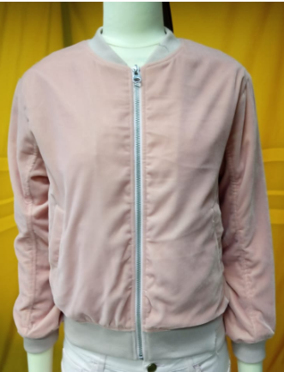
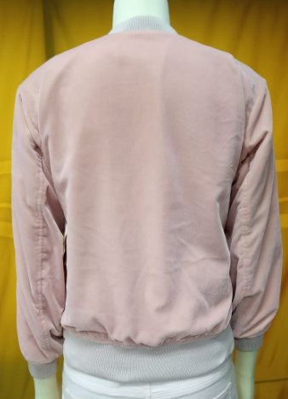
BUYER : H&M
STYLE : CROPPED BOMBER
FOB : $10
FABRIC : 100% POLYESTER
WASH : NON WASH
ITEM : GIRLS JACKET

Slide 4
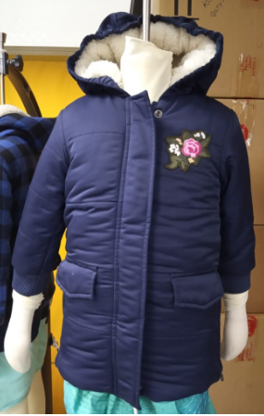
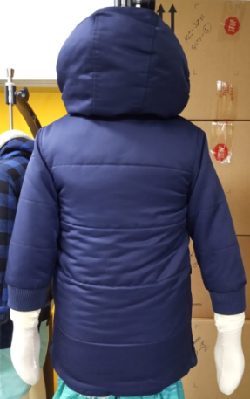
BUYER :BENETTON
STYLE : 2DRX53D70
FOB : $17
FABRIC : 100% POLYESTER TWILL
LINING: SHERPA FABRIC
PADDING: 80GSM
WASH : NON WASH
ITEM : GIRLS JACKET

Slide 5
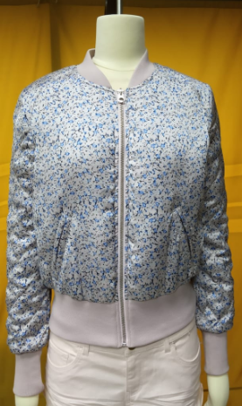
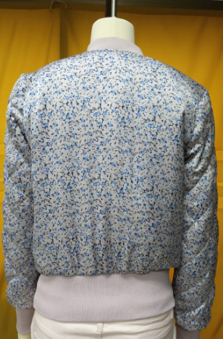
BUYER : H&M
STYLE : SHINY BOMBER
FOB : $9.00
FABRIC : 100% POLYESTER
WASH : NON WASH
ITEM : GIRLS JACKET

Slide 6
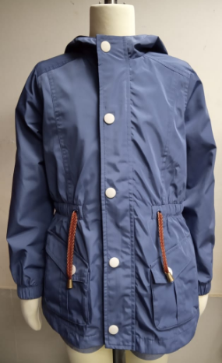
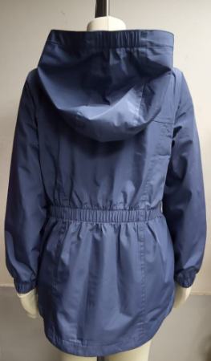
BUYER : TEMA
STYLE : ALEX
FOB : $10
FABRIC : 100% POLYESTER
WASH : NON WASH
ITEM : GIRLS JACKET

Slide 7
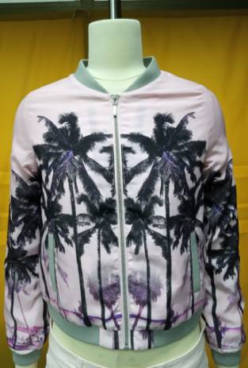
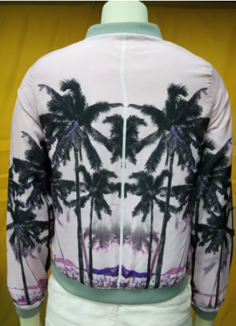
BUYER : LA-HALLE
STYLE : FESTIVITE
FOB : $9.00
FABRIC : 100% POLYESTER AOP
WASH : NON WASH
ITEM : GIRLS JACKET

Slide 8
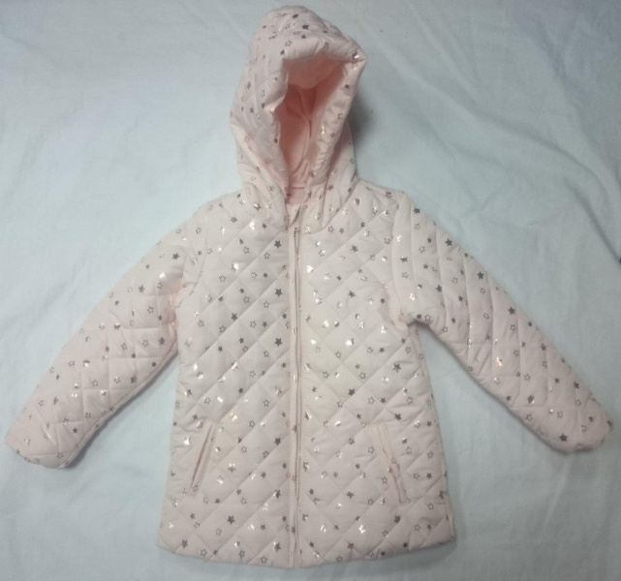
Style : CADDE
Shell: 100% polyester Printed 300T, Pongee, 40Dx40D/ 80G/M2 (without coating)
Lining: 100% cotton, S/J, 30/1, 150gsm, solid dyed, reactive dyed
Hood: Thermo 100gsm
MOQ :
FOB: US$7.93

Slide 9
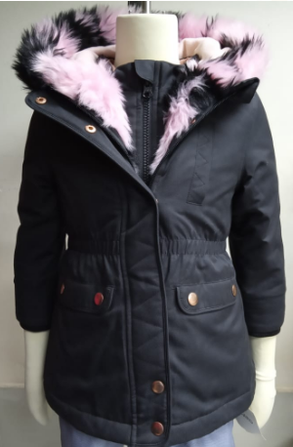
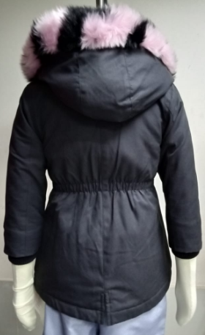
BUYER : SHOP DIRECT
STYLE : MINI V 283
FOB : $18
FABRIC : 65% CTN 35% POLY
WASH : NON WASH
ITEM : GIRLS JACKET

Slide 10
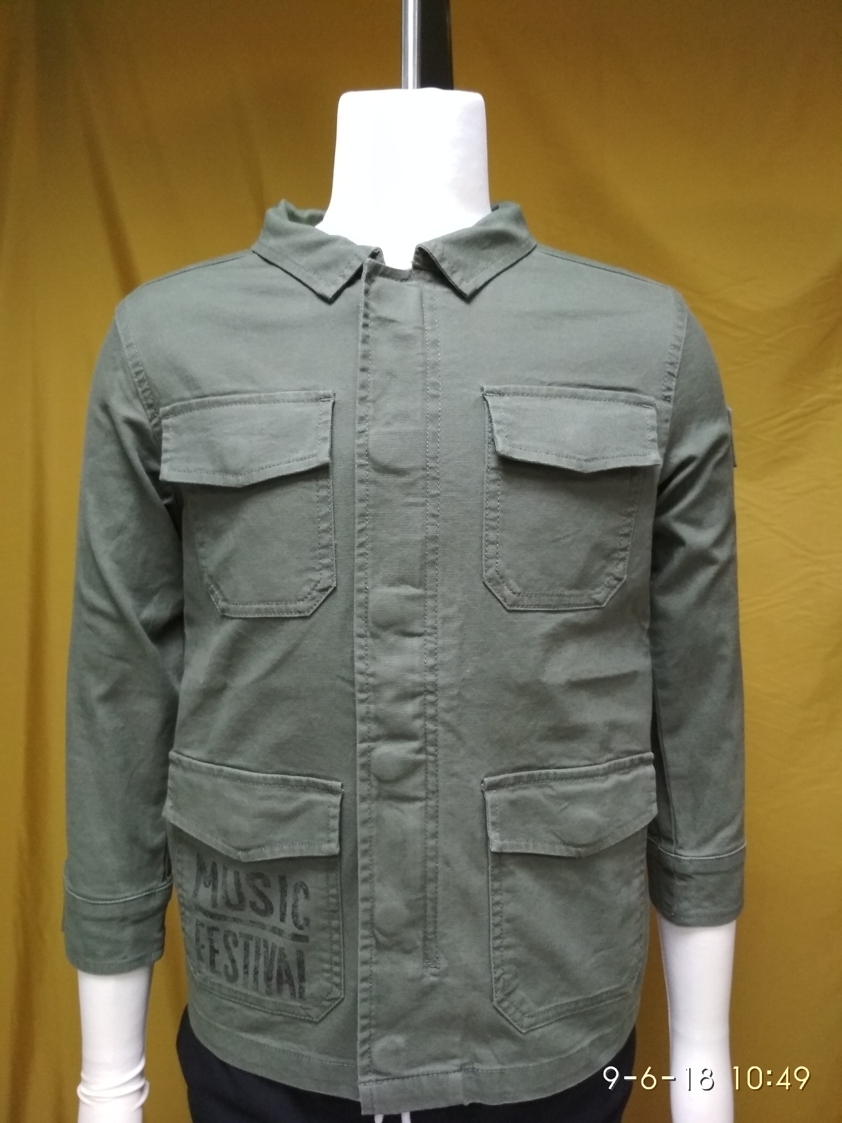
STYLE : 2BP353FG0
FOB : USD 12.50
FABRIC : 97% COTTON, 3% SPANDEX
WASH : ENZYME+ SOFTENER.
ITEM : BOY’S JACKET.

Slide 11
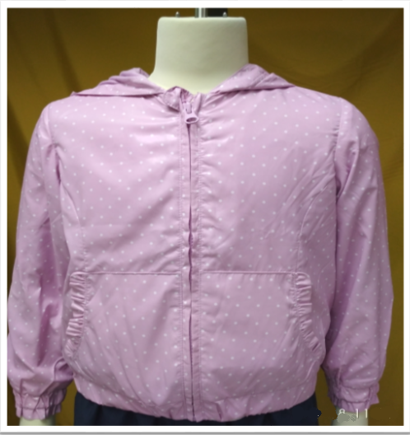
STYLE : 2AN453EMO
FOB : USD 8.20
FABRIC : 100% POLYESTER
WASH : NON WASH
ITEM : GIRL’S JACKET

Slide 12
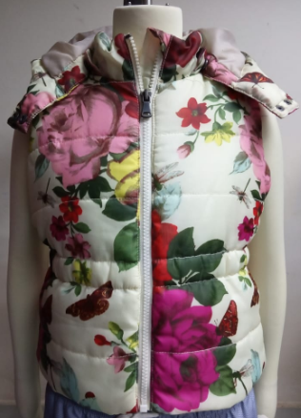
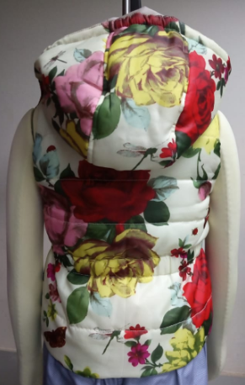
BUYER : H&M
STYLE : AOP GIRLS VEST
FOB :
FABRIC : 100% POLYESTER AOP
WASH : NON WASH
ITEM : GIRLS JACKET

Slide 13

BOYS AND KIDS JACKET

Slide 14
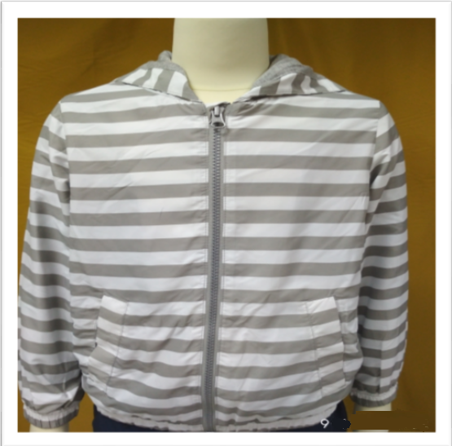
STYLE : 2AG953BP0
FOB : USD 8.15
FABRIC : 100% POLYESTER
WASH : NON WASH
ITEM : BOY’S JACKET

Slide 15
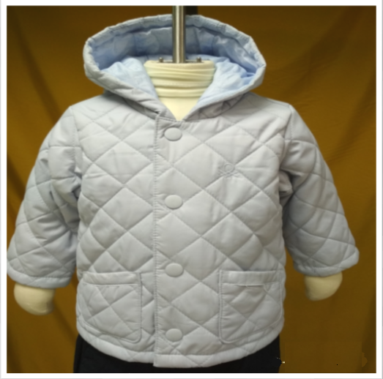
BUYER :BENETTON
STYLE : 2WU05341E
FOB : USD 7.50
FABRIC : 100% POLYESTER
WASH : NON WASH
ITEM : BABY JACKET

Slide 16
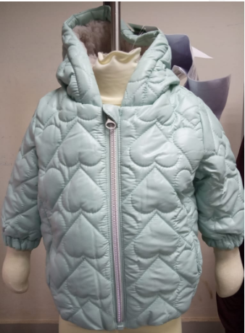
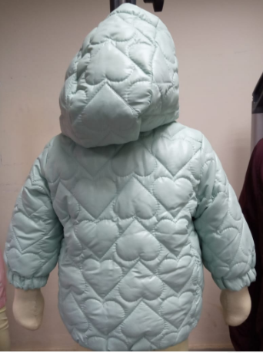
BUYER :BENETTON
STYLE : 2E005353BE
FOB : $11
FABRIC : 100% POLYESTER CIRE ON FACE
WASH : NON WASH
ITEM : BABYS JACKET

Slide 17
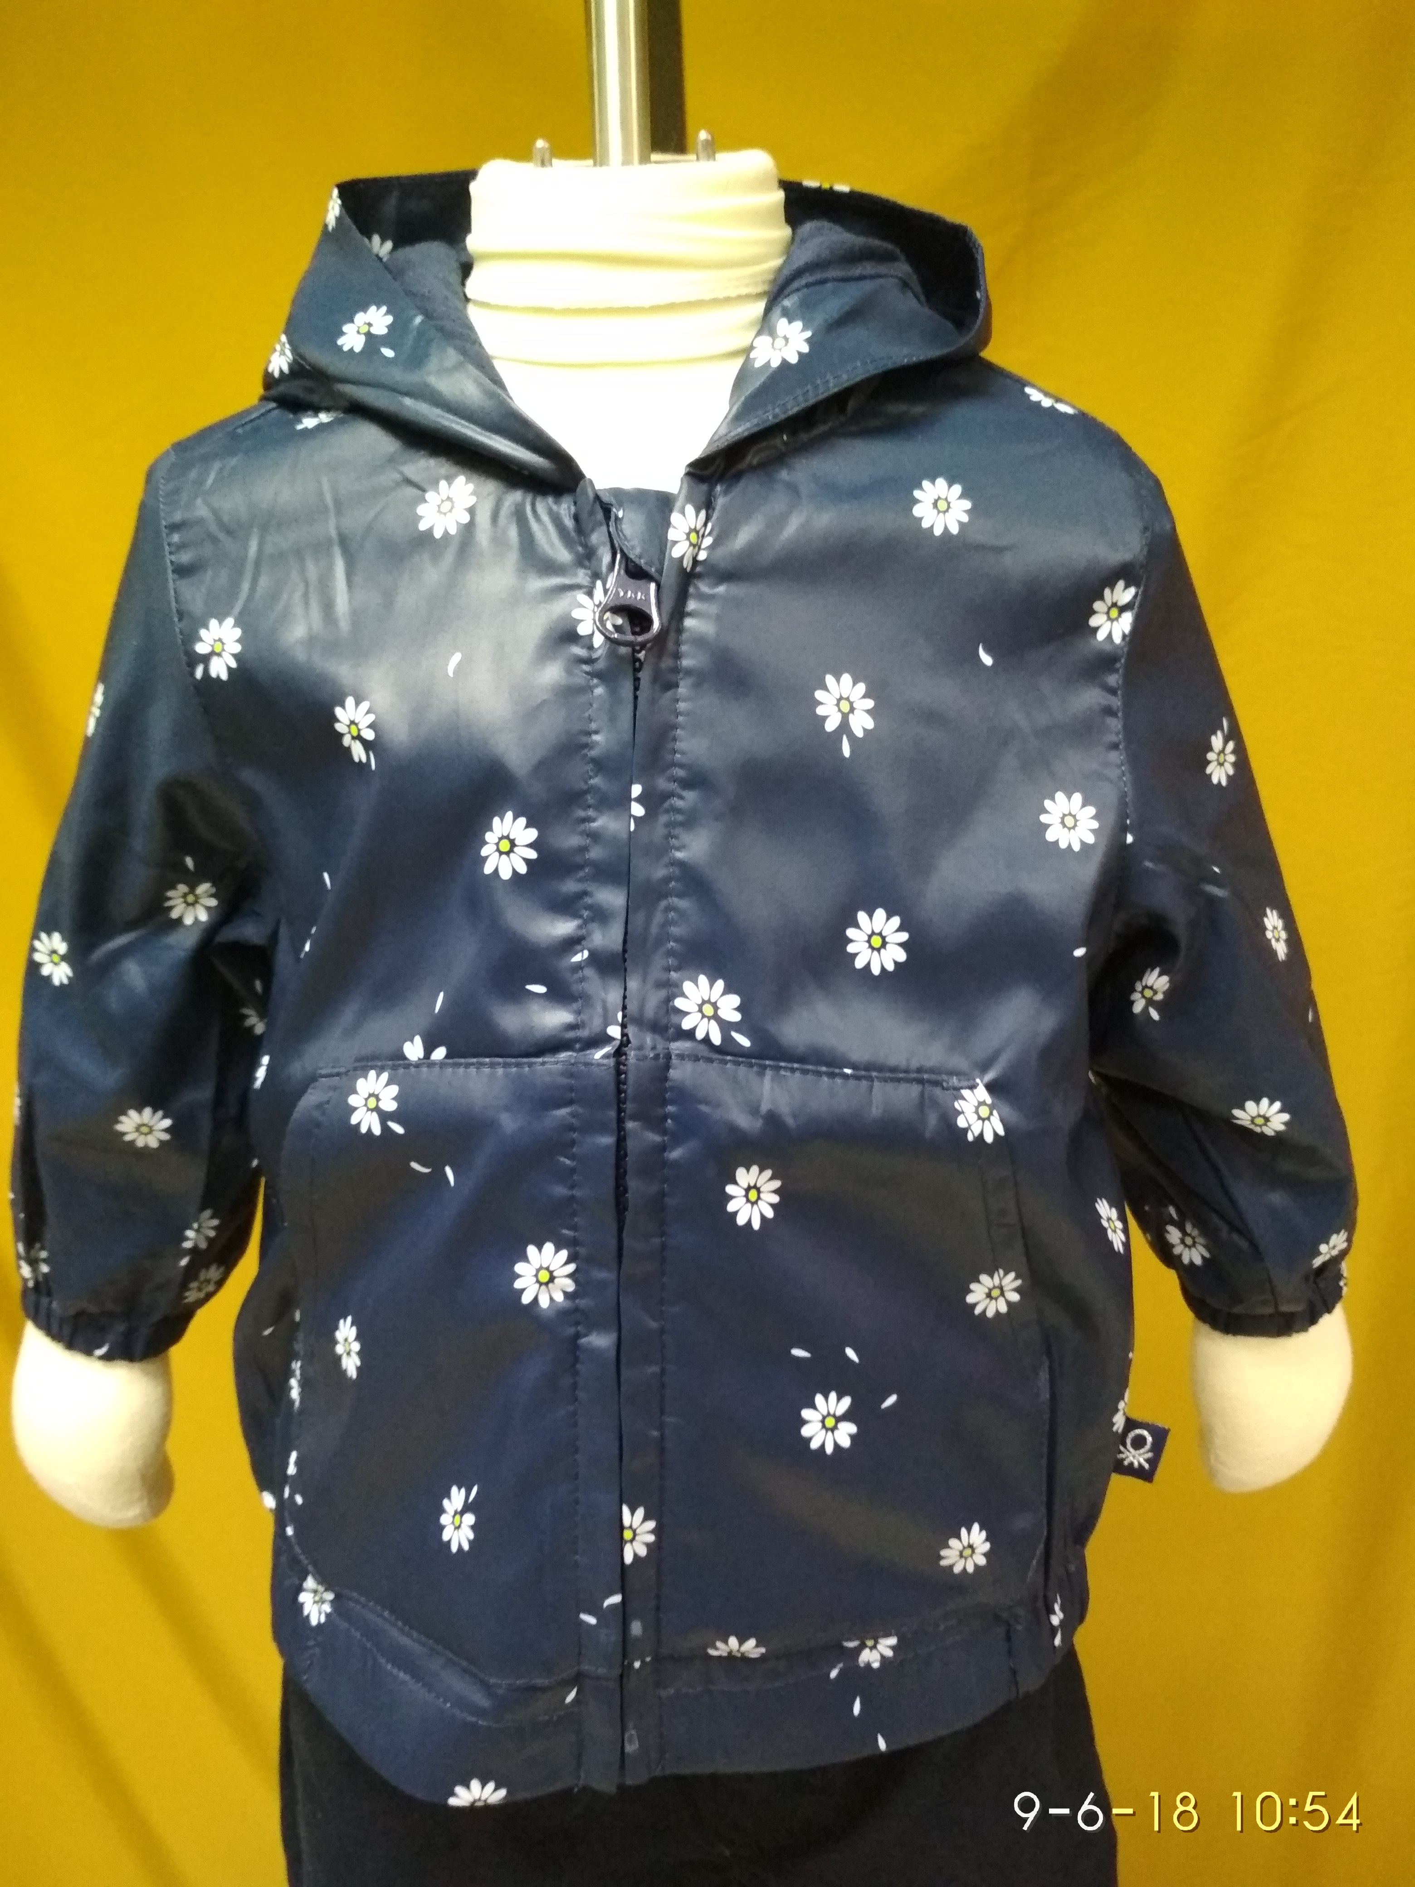
BUYER : BENETTON
STYLE : 2WR6530XE
FOB : USD 5.60
FABRIC : 100% POLYESTER
WASH : NON WASH
ITEM : BABY’S JACKET.

Slide 18
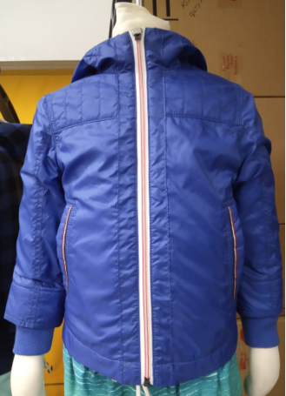
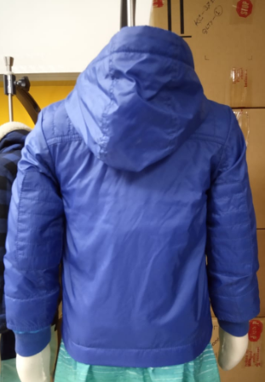
BUYER : BENETTON
STYLE : 2BL553640
FOB : $9.40
FABRIC : 100%Nylon 380T
WASH : NON WASH
ITEM : BOYS JACKET

Slide 19
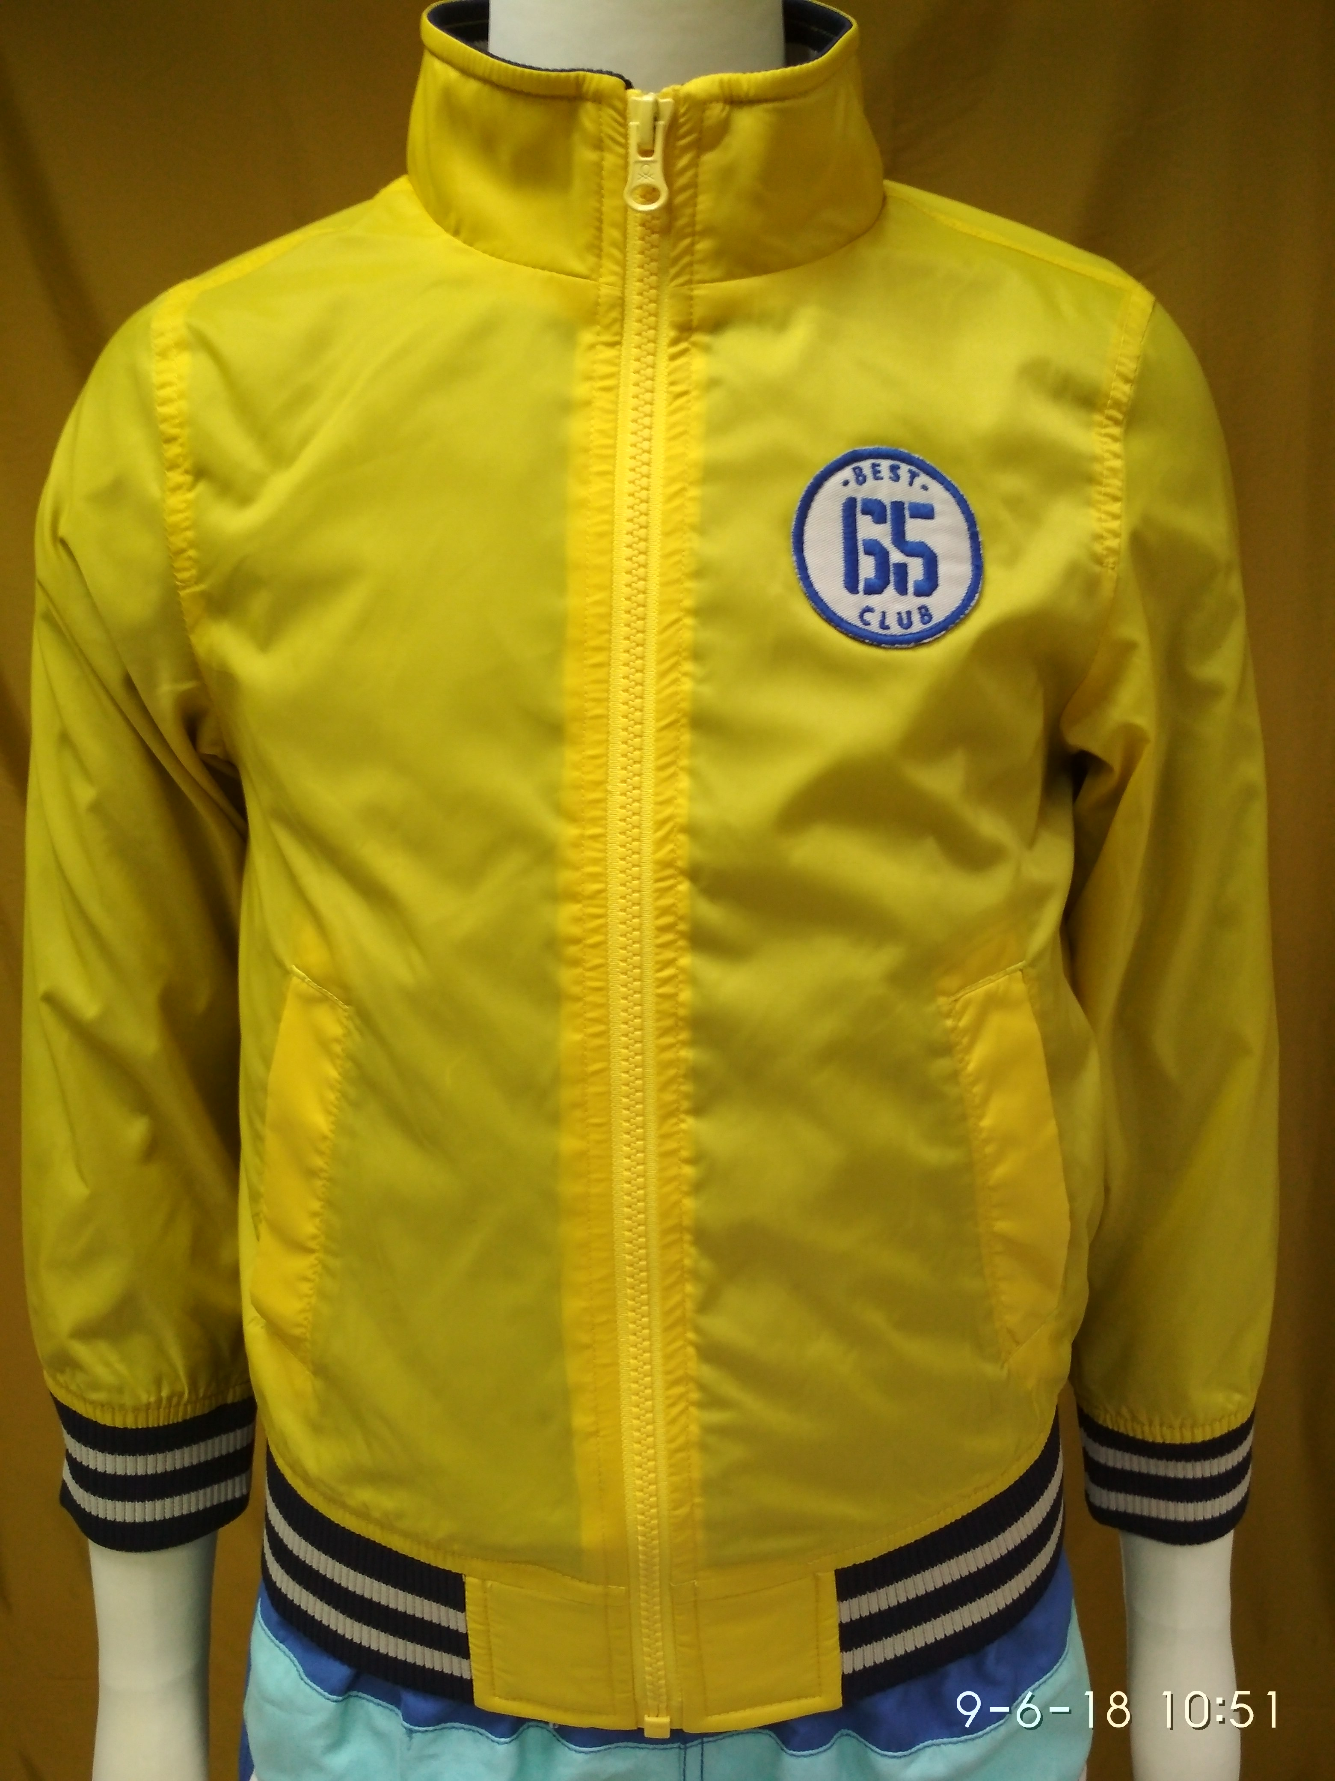
BUYER : BENETTON
STYLE : 2BL553F60
FOB : USD 9.10
FABRIC : 100% NYLON
WASH : NON WASH
ITEM : BOY’S JACKET.

Slide 20
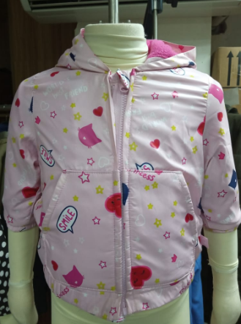
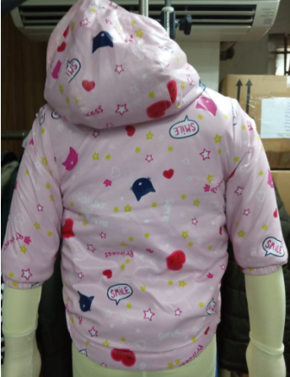
BUYER : BENETTON
STYLE : 2DKN534XE
FOB : $7.00
FABRIC : 100% Polyester AOP
LINING:POLAR FLEECE
WASH : NON WASH
ITEM : BABYS JACKET

Slide 21
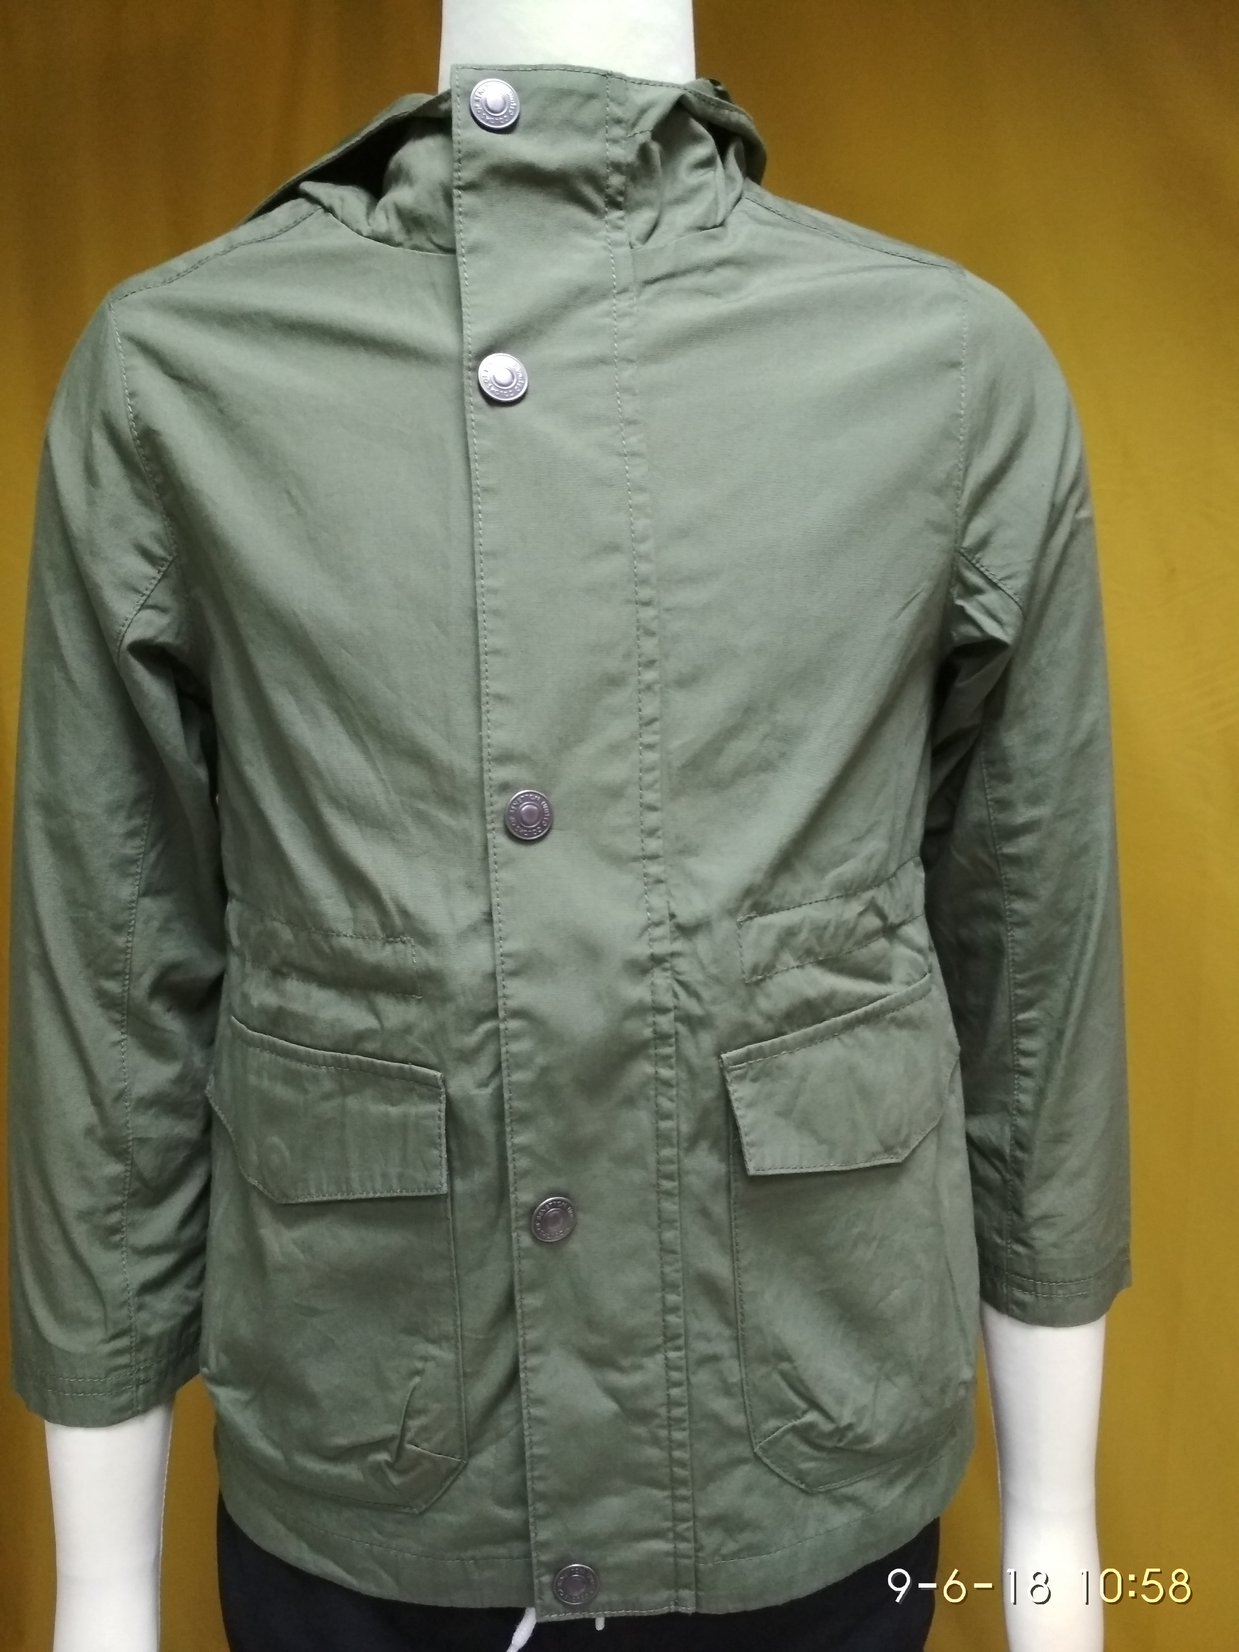
STYLE : 21A153EH0
FOB : USD 11.50
FABRIC :100% COTTON
WASH : ENZYME+ SOFTENER.
ITEM : BOY’S JACKET.

Slide 22
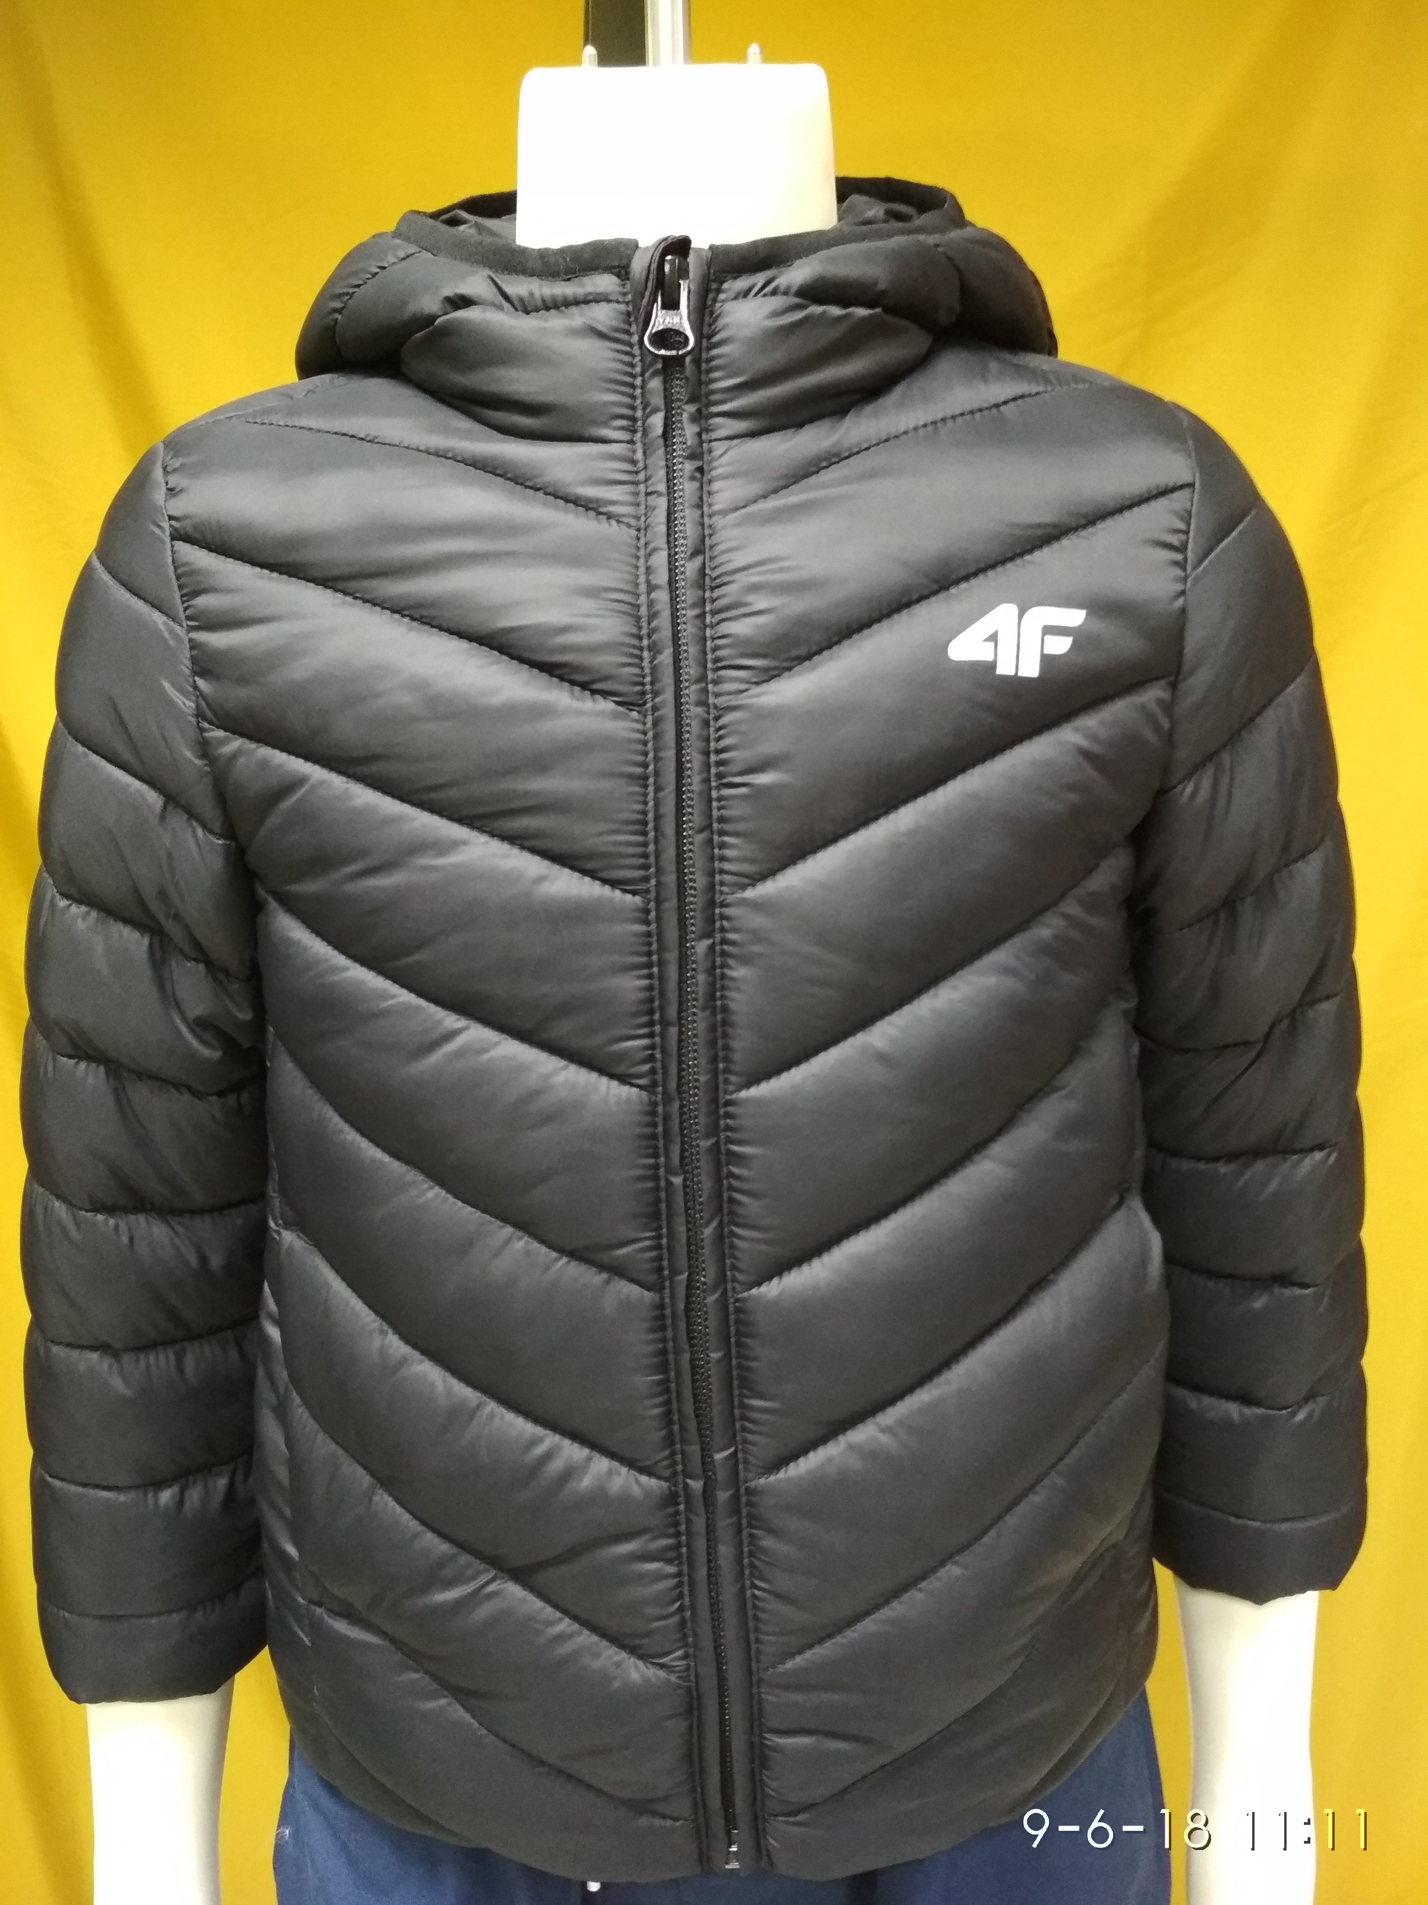
STYLE : J4Z19-JKUMP100
FOB : USD 12.00
FABRIC : 100 % POLYAMIDE 380 T
WASH : NON WASH
ITEM : BOY’S JACKET.

Slide 23
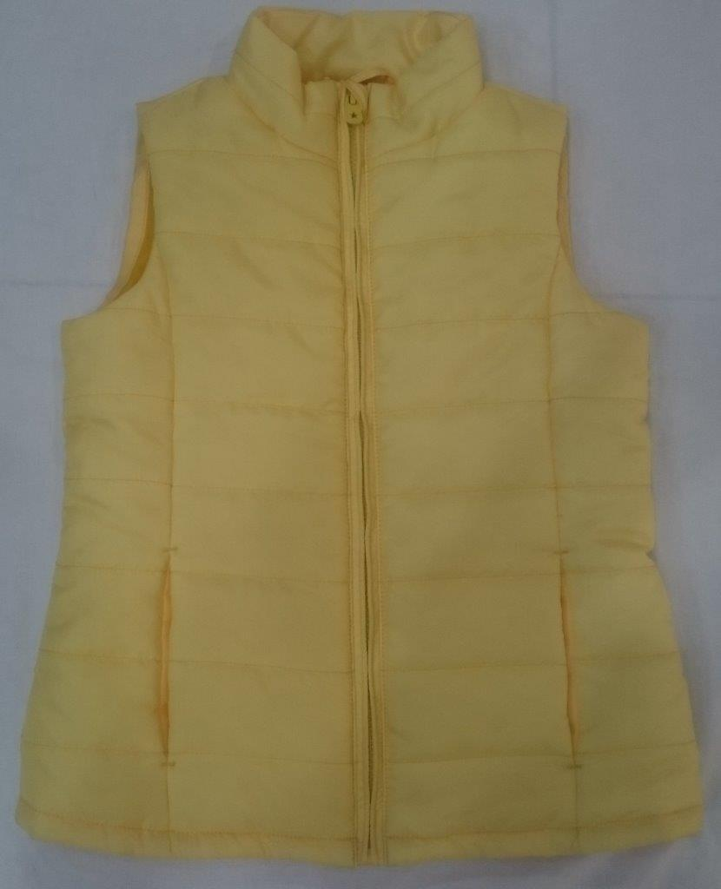
Style : Akademik Vest
Shell: 100% polyester
Lining: 210T Taffeta
Padding: 200gsm
MOQ :
FOB: US$6.80

Slide 24
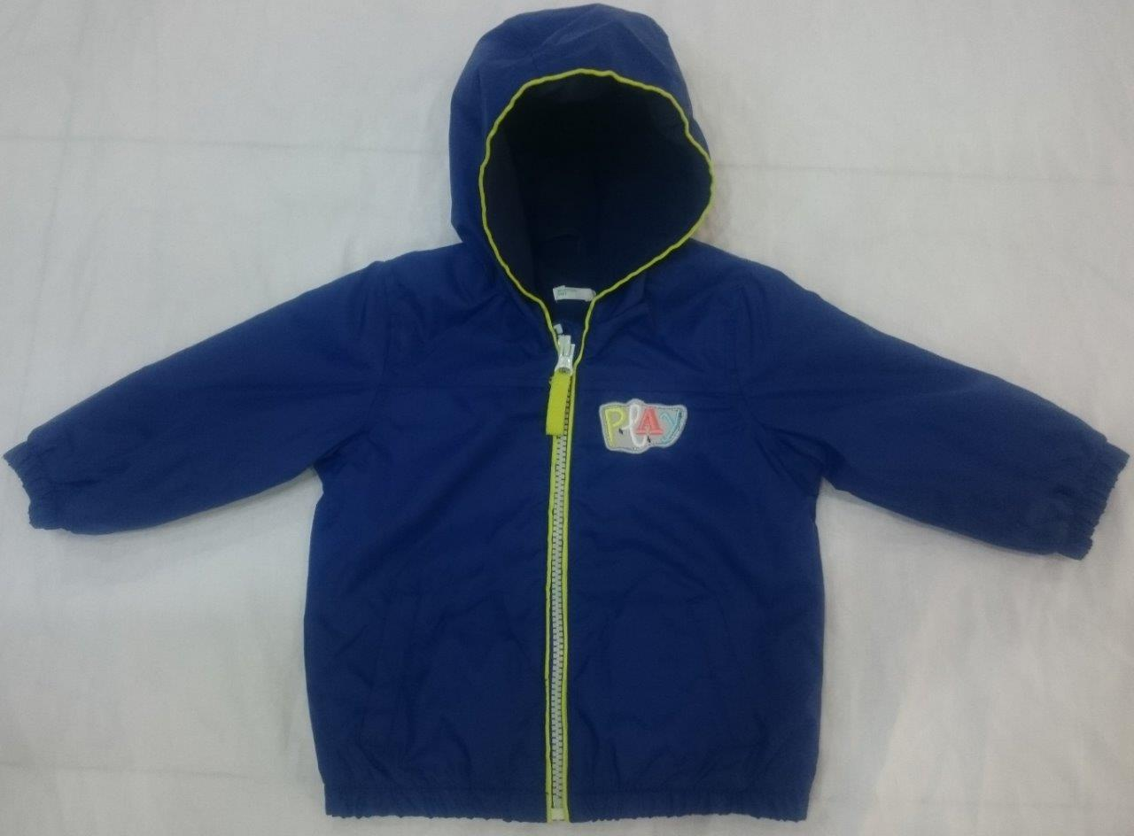
Style : 2KZ3533AE
Shell: 100% polyester
Lining: 100% micro Fleece 210gsm (both side brush)
MOQ :
FOB: $8.47

Slide 25
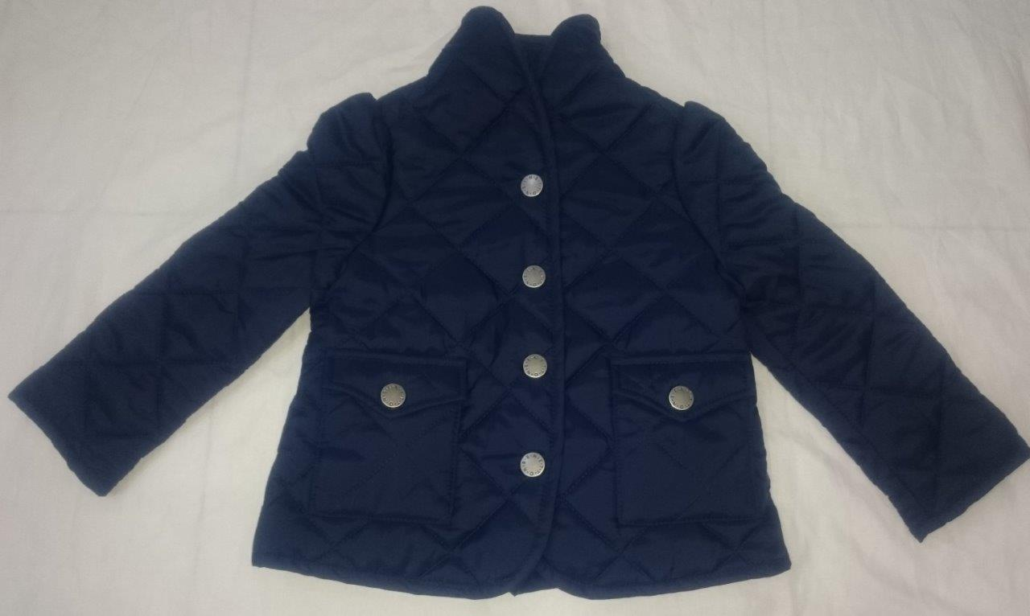
Style : 2DKB520W0
Shell: 100% Nylon
Padding: Super soft YSS 150 GSM (both side)
MOQ :
FOB: $9.90

Slide 26
Thank You

